Slide 1

Server and Systems Administration Module Code : CSC3504
Simeon NDAYAMBAJE
Server and Systems Administration , CSC3504
1

Slide 2
Chapter 2
Servers & Virtualization

Slide 3
Server Types
List Server:
Telnet Server:
Open Source Server:
Virtual Server:
Print server:
Communications server:
Application server:
Database server:
Domain server:

Slide 4
Server Types
Proxy Server: A proxy server sits between a client program (typically a Web browser) and an external server (typically another server on the Web) to filter requests, improve performance, and share connections.
Mail Server: Mail servers send and receive email using standard email protocols. For example, the SMTP protocol sends messages and handles outgoing mail requests. The IMAP and POP3 protocols receive messages and are used to process incoming mail.

Slide 5
Server Types
Server Platforms: A family of servers that includes the hardware and operating system. For example, the Windows server platform refers to x86 CPUs and some server version of Windows such as Windows Server 2012.
A Web server: is a program that uses HTTP (Hypertext Transfer Protocol) to serve the files that form Web pages to users, in response to their requests, which are forwarded by their computers' HTTP clients. Dedicated computers and appliances may be referred to as Web servers as well.

Slide 6
Server Types
Application Server: An application server is a software framework that provides both facilities to create web applications and a server environment to run them. It sits between the network and the database,
Real-Time Communication Server: Real-time communication servers, formerly known as chat servers or IRC Servers, and still sometimes referred to as instant messaging (IM) servers, enable large numbers users to exchange information near instantaneously.

Slide 7
Server Types
FTP Server: In the client/server model, a file server is a computer responsible for the central storage and management of data files so that other computers on the same network can access the files. ... A program or mechanism that enables the required processes for file sharing can also be called a file server.
Collaboration Server: Collaboration software designed to enable users to collaborate, regardless of location, via the Internet or a corporate intranet and to work together in a virtual atmosphere.

Slide 8
Server Types
A list server (mailing list server) is a program that handles subscription requests for a mailing list and distributes new messages, newsletters, or other postings to the entire list of subscribers as they occur or are scheduled for advertising purpose.
Telnet Server: A Telnet server enables users to log on to a host computer and perform tasks as if they're working on the remote computer itself. Using telnet client software on your computer, you can make a connection to a telnet server (i.e., the remote host).

Slide 9
Server Types
Open Source Server: In general, open source refers to any program whose source code is made available for use or modification as users or other developers see fit. Open source software is usually developed as a public collaboration and made freely available. Eg Apache HTTP Server, Apache, Tomcat
Virtual Server: A virtual server is a server that shares hardware and software resources with other operating systems (OS), versus dedicated servers.

Slide 10
Server Types
Print server: Manages the printers that are connected to the network and the printing of user documents on the network printers
Communications server: Handles many common communications functions for the network, such as e-mail, fax, remote access, firewalls or Internet services
Database server: Manages common databases for the network, handling all data storage, database management and requests for data

Slide 11
Virtualization?

Slide 12
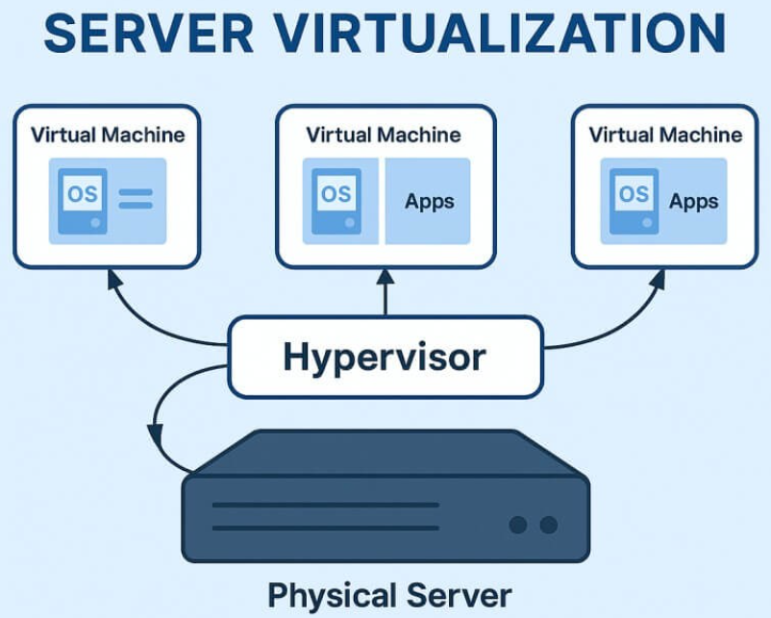
What is Virtualization
Virtualization is the technology that allows you to run multiple virtual machines (VMs) on a single physical host, sharing resources like CPU, memory, storage, and network, while isolating each VM from the others.

Slide 13
What is Virtualization?
virtualization means to create a virtual version of a device or resource, such as a server, storage device, network or even an operating system where the framework divides the resource into one or more execution environments.

Slide 14
What is Virtualization
It allows multiple virtual systems (operating system, server, storage device, or network resources)to run on a single physical hardware system.
Containerization packages software code together into its own container

Slide 15
What is a hypervisor?
Hypervisor or virtual machine monitor (VMM) is program make virtualization possible.
It sit on top of the physical server and handle all the work of creating and running virtual machines.
It is manager that keeps everything running smoothly in the background.
Tasks: dividing up the server’s power, memory, and storage so each virtual machine gets what it needs without stepping on the others.

Slide 16
What is hypervisor or virtual machine monitor (VMM)?
A hypervisor is a program (software) that creates and runs virtual machines it would enable you to host several different virtual machines on a single hardware.

Slide 17
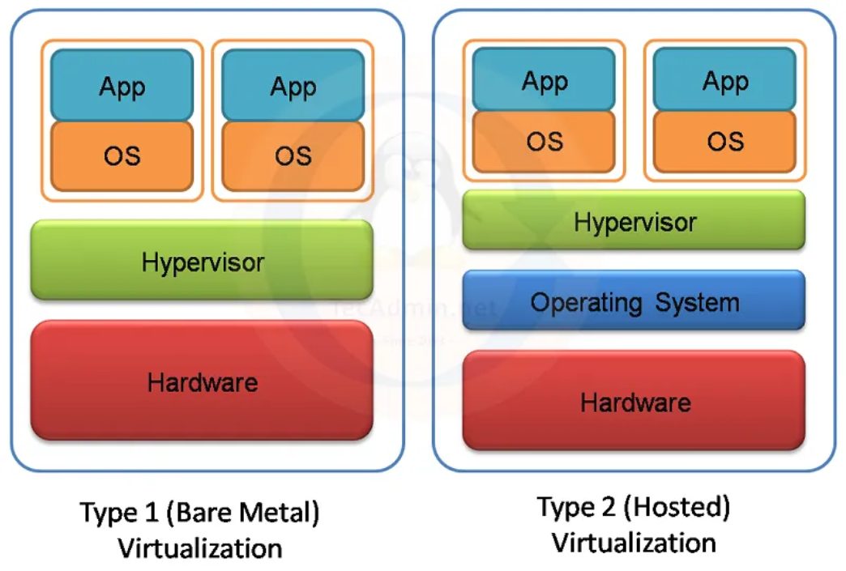
Types of Hypervisor
Hypervisors come in two types.
Type 1((Bare-Metal)runs directly on the server’s hardware, while
Type 2(Hosted / Software) runs inside an existing operating system like a regular application.

Slide 18
Why Virtualization is Important
Resource Optimization: Efficient use of server hardware
Cost Reduction: Fewer physical servers → lower hardware and energy costs
Isolation & Security: Each VM runs independently
Scalability & Flexibility: Quickly create, clone, or migrate VMs
Simplified Management: Easier deployment, backup, and disaster recovery

Slide 19
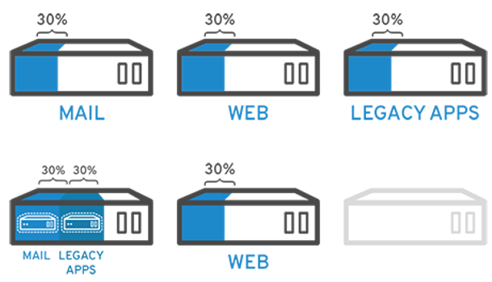
Why implement visualization in organization?

Slide 20
Why implement visualization in organization?
Reduce datacenter costs by reducing your physical infrastructure and improving your server to admin ratio
Get more out of your existing resources:
Increase availability of hardware and applications for improved business continuity:
Gain operational flexibility:
Improve desktop manageability and security:

Slide 21
Why implement Virtualization in organization?
Save money by Reduce number of servers
Save energy. Virtualization reduces the number of physical servers, reducing the energy required to power and cool them.
Save time. With fewer servers, you can spend less time on the manual tasks required for server maintenance. Gain operational flexibility:
Reduce desktop management headaches.

Slide 22
Advantages of Virtualization
Reduced hardware costs
Increased resource utilization
Easy backup and disaster recovery
Isolation for security and testing
Simplifies deployment of applications

Slide 23
Disadvantages / Challenges of Virtualization
Performance overhead (especially with Type 2 hypervisors)
Requires skilled administrators
Licensing costs for enterprise hypervisors
Resource contention if too many VMs run on a single host

Slide 24
Components of Virtualization
Hypervisor / VMM: Manages and allocates hardware resources to VMs
Virtual Machines (VMs): Isolated environments running guest OS
Guest OS: Operating system installed inside the VM
Host OS: Operating system running on physical hardware (Type 2)
Virtual Hardware: Virtual CPU, memory, network interfaces, storage

Slide 25
Types of Virtualization
Hardware Virtualization
Operating System Virtualization (Containerization)
Network Virtualization
Storage Virtualization

Slide 26
Types of Virtualization(cont..)
1 Hardware Virtualization
Allows multiple operating systems to run on a single physical machine.
Achieved using a hypervisor (also called a Virtual Machine Monitor, VMM)
Types of hypervisors:
Type 1 (Bare-metal Hypervisor): Runs directly on hardware. Examples: VMware ESXi, Microsoft Hyper-V
Type 2 (Hosted Hypervisor): Runs on top of an existing OS.Examples: VMware Workstation, Oracle VirtualBox

Slide 27
Types of Virtualization(cont..)
2 Operating System Virtualization (Containerization)
Runs multiple isolated user-space instances on a single OS kernel
Lightweight compared to full VMs
Used in microservices and cloud-native applications
Examples:
Docker
LXC (Linux Containers)

Slide 28
Types of Virtualization(cont..)
3 Network Virtualization
Abstracts physical network resources into virtual networks
Enables multiple virtual networks on a single physical infrastructure
Key technologies: VLANs, VXLANs, SDN (Software Defined Networking)

Slide 29
Types of Virtualization(cont..)
4 Storage Virtualization
Combines multiple physical storage devices into a single logical unit
Simplifies management, improves scalability, and enhances fault tolerance
Examples: SAN (Storage Area Network), NAS (Network Attached Storage)

Slide 30
Types of Server Virtualization Solutions
There are 3 types of server virtualization based on level of isolation and ability to mimic hardware resources.
Full Virtualization
Paravirtualization
OS-Level Virtualization

Slide 31
Full Virtualization Solutions
Full Virtualization allows a complete operating system to run unmodified on virtual hardware.
The hypervisor fully emulates the underlying hardware so the guest OS does not know it is running inside a virtual machine.
This virtualization software monitors and sends information and resources directly from the physical server while still running on its own
Typical Example: VMware ESXi, Oracle VM VirtualBox

Slide 32
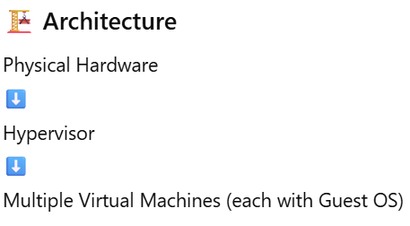
Full Virtualization Solutions
How Full Virtualization Works
A hypervisor sits between hardware and virtual machines.
The hypervisor emulates CPU, memory, disk, and network.
Each VM runs its own guest OS independently.
The guest OS does not need modification.

Slide 33
Full Virtualization Solutions
Example Scenario:
A company runs:
Windows Server VM
Ubuntu Linux VM
CentOS VM
All on the same physical server — each unaware it is virtualized.

Slide 34
Paravirtualization Solutions
Paravirtualization is a virtualization technique where the guest OS is modified to communicate directly with the hypervisor for better performance.
The guest OS is aware it is running in a virtualized environment.
the operating systems are aware of each other yet they can communicate with the hypervisor directly through ‘hyper calls’ – enabled by an effective Application Programming Interface (API).

Slide 35
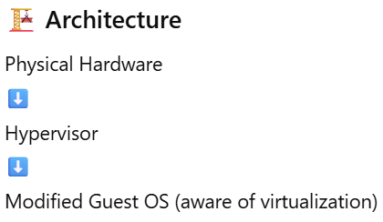
Paravirtualization Solutions
How It Works
The hypervisor provides special APIs.
The guest OS is modified to use these APIs.
Instead of fully emulating hardware, it cooperates with the hypervisor.

Slide 36
OS-Level Virtualization Solutions
OS-Level Virtualization allows multiple isolated user environments (containers) to run on a single operating system kernel” allows the use of multiple virtual spaces➔ There is no separate guest OS per container.”
The term "containerization" refers to a type of virtualization that doesn't need a hypervisor. Instead, it uses the host operating system's own virtualization capabilities as the hypervisor.
This virtualization method is also restricted to having the same operating system as its host to function.

Slide 37
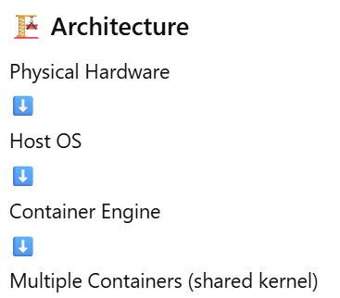
OS-Level Virtualization Solutions
How It Works
Uses the host OS kernel.
Isolates applications using namespaces and control groups (cgroups).
Containers share the same kernel but run independently.

Slide 38
OS-Level Virtualization Solutions
Typical Example
Docker
Kubernetes
Example Scenario:
A server runs:
Container 1 → Node.js app
Container 2 → MySQL database
Container 3 → Python API
All share the same Linux kernel but are isolated.

Slide 39
Thank you

